Slide 1
Database on State Civil Supplies Corporation Ltd
GROUP 9
By:-
Yash Pandia (202112004)
Renish Gadhiya (202112037)
Abhinav Kakade (202112041)
Parth Kaneriya (202112084)

Slide 2
1. Introduction
SCSCL is an organization that deals with the purchase and distribution of different agricultural commodities.
The farmers sell a fixed quantity of each commodity to SCSCL at a pre-decided rate. Farmer can sell a particular commodity to SCSCL only once with one farmer id during a season.
After purchasing the commodities, SCSCL stores them in their warehouses located nearby the purchase center and from there, it is sent to the shops from which it is sold to the public at a minimum rate.

Slide 3
2. Motivation
The ecosystem of distribution of crops from the farmer to the public is quite complex.
Lots of relational entities are involved in this process.
Hence, a lot of information is required for this particular topic. Because of this, quite a number of queries can be generated using this information, which helps us to improve our understanding of this database creation.

Slide 4
3. Scope
Records of personal details of Farmers.
Details of Employees working in SCSCL.
Details of Manager.
Details of Purchase made by SCSCL.
Details of Purchase Center.
Details of Warehouses.
Details of Warehouse Stock.
Details of Warehouse Transport.
Details of Shop Transport.
Details of Shops.

Slide 5
4. ER Diagram & Relational Schema
ER DIAGRAM
Relational Schema Diagram

Slide 6
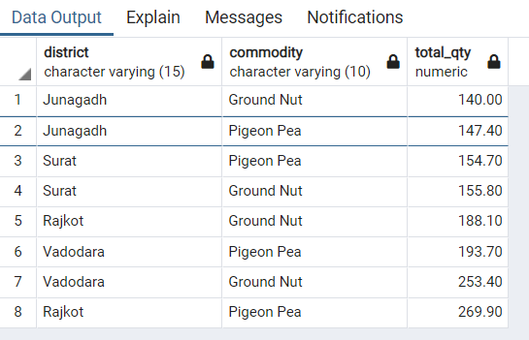
5. Queries
1. What is the Total Qty of commodity purchased by each district?
select district,commodity,sum(qty_in_quintal) as total_qty from farmers as f
join purchase as p on f.farmer_id = p.farmer_id group by district, commodity
order by total_qty asc;

Slide 7
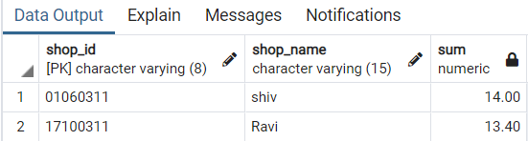
2. What is the total quantity of commodities transferred to the
shops in ‘Vanthali’ taluka between 25th October 2020 and 25th October 2021?
select s.shop_id,shop_name,sum(qty_in_quintal) from shop as s join shop_transport as t on s.shop_id=t.shop_id where taluka ='Vanthali' and tp_date between '2020-10-25' and '2021-10-25' group by s.shop_id, shop_name;

Slide 8
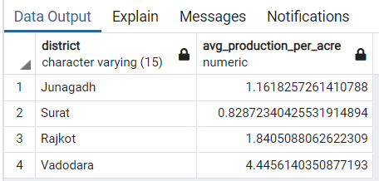
3. What is the average production of Ground Nut Per acre?
select district,(sum(qty_in_quintal)/sum(land_area_in_acre)) as avg_production_per_acre from farmers as f join purchase as p on f.farmer_id=p.farmer_id where commodity='Ground Nut' group by (district);

Slide 9
6. Summary
This database will help us in finding out the details of farmers such as their bank details, land area, location of their land, crop production in each season etc.
It helps SCSCL to manage the purchase details of different commodities.
It also helps them to manage the data of transfer of commodities from purchase center to warehouse and from warehouse to different shops.
Stocks table of database helps to manage the stocks of different commodities at warehouses.
It also gives the information about employees and Manager.
It helps SCSCL to find the different data like average production of commodities per acre, average income of farmer, district wise crop production, total amount paid by SCSCL to the farmers every year.

Slide 10
Thank You

